Slide 1
2월 9일 조별과제
영화평점 크롤러 소스
분석해서 보고서로 제출하기
(결과화면캡쳐할것)

Slide 2
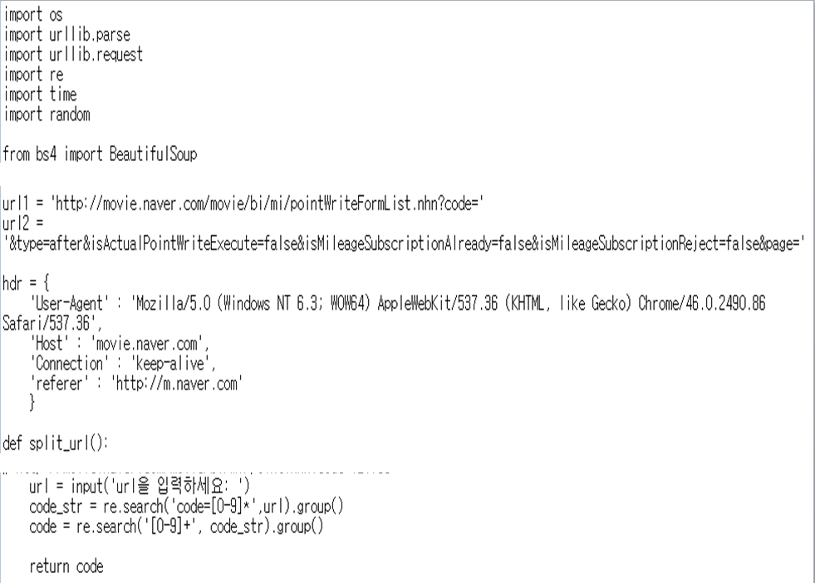
Notes:
import os
import urllib.parse
import urllib.request
import re
import time
import random
from bs4 import BeautifulSoup
url1="http://movie.naver.com/movie/bi/mi/pointWriteFormList.nhn?code="
url2="&type=after&isActualPointWriteExecute=false&isMileageSubscriptionAlready=false&isMileageSubscriptionReject=false&page="
hdr={
'User-Agent':'Mozilla/5.0(Windows NT 6.3; WOW64) AppleWebKit/537.36(KHTML, like Gecko) Chrome/46.0.2490.86Safari/537.36',
'Host':'movie.naver.com',
'Connection':'keep-alive',
'referer':'http://m.naver.com'
}
def split_url():
url=input("url을 입력하세요:")
code_str=re.search('code=[0-9]*',url).group()
code=re.search('[0-9]+',code_str).group()
return code
def fetch_score_result(URL):
print(URL)
result={}
result_list=[]
res=urllib.request.Request(URL, headers=hdr)
response=urllib.request.urlopen(res)
html=response.read()
soup=BeautifulSoup(html,'html.parser')
score_result=soup.find('div', class_='score_result').find('ul')
lis=score_result.find_all('li')
for li in lis:
score=li.find('div',class_='star_score').find('em').get_text()
spectator=li.find('div',class_='score_reple').find('span').get_text()
review=li.find('div',class_='score_reple').find('p').get_text()
if spectator=='관람객':
review=review[3: ]
result['score']=score
result['review']=review
result_list.append({
'score':score,
'review':review
})
return result_list
def input_save_path():
save_path=str(input("input save path: "))
save_path=save_path.replace('\\','/')
if not os.path.isdir(os.path.split(save_path)[0]):
os.mkdir(os.path.split(save_path)[0])
return save_path
def fetch_reviews():
code=split_url()
f=open(input_save_path(), 'w', encoding='utf-8')
page=1
while True:
count=int(input("게시물의 검색 개수를 입력하세요(10단위): "))
if count%10==0:
break
I_count=1
isLoop=True
while isLoop:
URL=url1+code+url2+str(page)
result_list=fetch_score_result(URL)
for r in result_list:
f.write('=='*40+'\n')
f.write('영화 평점: '+ r['score']+'\n')
f.write('리뷰 내용: '+ r['review']+'\n')
f.write('=='*40+'\n')
I_count+=1
if I_count>count:
isLoop=False
break
page+=1
if not isLoop or I_count==count:
isLoop=False
break
sleepTime=random.randint(4,10)
time.sleep(sleepTime)
print(str(sleepTime)+ '초 기다렸습니다.')
f.close()
fetch_reviews()

Slide 3
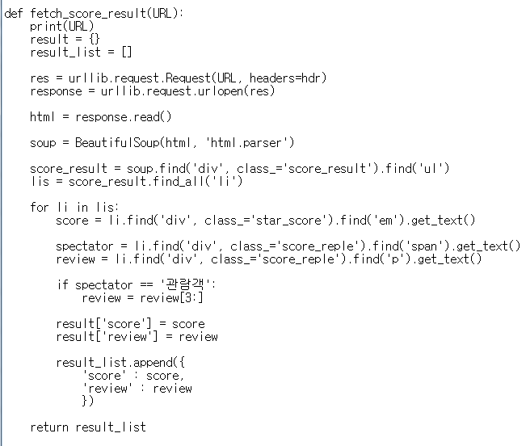

Slide 4
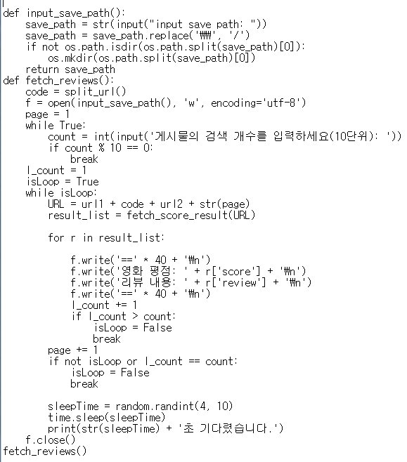
Notes:
import os
import urllib.parse
import urllib.request
import re
import time
import random
from bs4 import BeautifulSoup
url1="http://movie.naver.com/movie/bi/mi/pointWriteFormList.nhn?code="
url2="&type=after&isActualPointWriteExecute=false&isMileageSubscriptionAlready=false&isMileageSubscriptionReject=false&page="
hdr={
'User-Agent':'Mozilla/5.0(Windows NT 6.3; WOW64) AppleWebKit/537.36(KHTML, like Gecko) Chrome/46.0.2490.86Safari/537.36'
'Host':'Keep-alive'
'Connection':'keep-alive'
'referer':'http://m.naver.com'
}
def split_url():
url=input("url을 입력하세요:")
code_str=re.search('code=[0-9]*',url).group()
code=re.search('[0-9]+',code_str).group()
return code
def fetch_score_result(URL):
print(URL)
result={}
result_list=[]
res=urllib.request.Request(URL, headers=hdr)
response=urllib.request.urlopen(res)
html=response.read()
soup=BeautifulSoup(html,'html.parser')
score_result=soup.find('div', class_='score_result').find('ul')
lis=score_result.find_all('li')
for li in lis:
score=li.find('div',class_='star_score').find('em').get_text()
spectator=li.find('div',class_='score_reple').find('span').get_text()
review=li.find('div',class_='score_reple').find('p').get_text()
if spectator=='관람객':
review=review[3: ]
result['score']=score
result['review']=review
result_list.append({
'score':score,
'review':review
})
return result_list
def input_save_path():
save_path=str(input("input save path: "))
save_path=save_path.replace('\\','/')
if not os.path.isdir(os.path.split(save_path)[0]):
os.mkdir(os.path.split(save_path)[0])
return save_path
def fetch_reviews():
code=split_url()
f=open(input_save_path(), 'w', encoding='utf-8')
page=1
while True:
count=int(input("게시물의 검색 개수를 입력하세요(10단위): "))
if count%10==0:
break
I_count=1
isLoop=True
while isLoop:
URL=url1+code+url2+str(page)
result_list=fetch_score_result(URL)
for r in result_list:
f.write('=='*40+'\n')
f.write('영화 평점: '+ r['score']+'\n')
f.write('리뷰 내용: '+ r['review']+'\n')
f.write('=='*40+'\n')
I_count+=1
if I_count>count:
isLoop=False
break
page+=1
if not isLoop or I_count==count:
isLoop=False
break
sleepTime=random.randint(4,10)
time.sleep(sleepTime)
print(str(sleepTime)+ '초 기다렸습니다.')
f.close()
fetch_reviews()

Slide 5
[ 네이버 영화 평점 크롤러 사용 방법 ]
네이버에서 영화 를 검색창에 넣고 조회합니다.
여러 영화가 나오는 데 리뷰를 받고 싶은 영화를 누릅니다.
특정 영화를 누른 후 아래 부분의 평점탭을 누릅니다.
평점탭을 누른 후 맨 위 주소창의 주소를 CTRL + C 로 복사를 합니다.
5. 파이썬을 실행하여 네이버_무비_리뷰.py 를 불러 온 후 전체 코드를 선택한 후 F5 번을 눌러 실행합니다. 그러면 아래와 같이 URL 을 입력하라고 하는 창이 나오는데 이 때 앞의 4 번에서 복사했던 URL 을 붙여 넣기를 합니다.
input save path 는 리뷰를 저장할 경로와 이름을 원하는대로 지정하시면 됩니다.
게시물의 검색 개수는 크롤링 하길 원하는 리뷰 개수를 적어 주세요.
http://movie.naver.com/movie/bi/mi/point.nhn?code=151728
Notes:
http://movie.naver.com/movie/bi/mi/point.nhn?code=151728

Slide 6
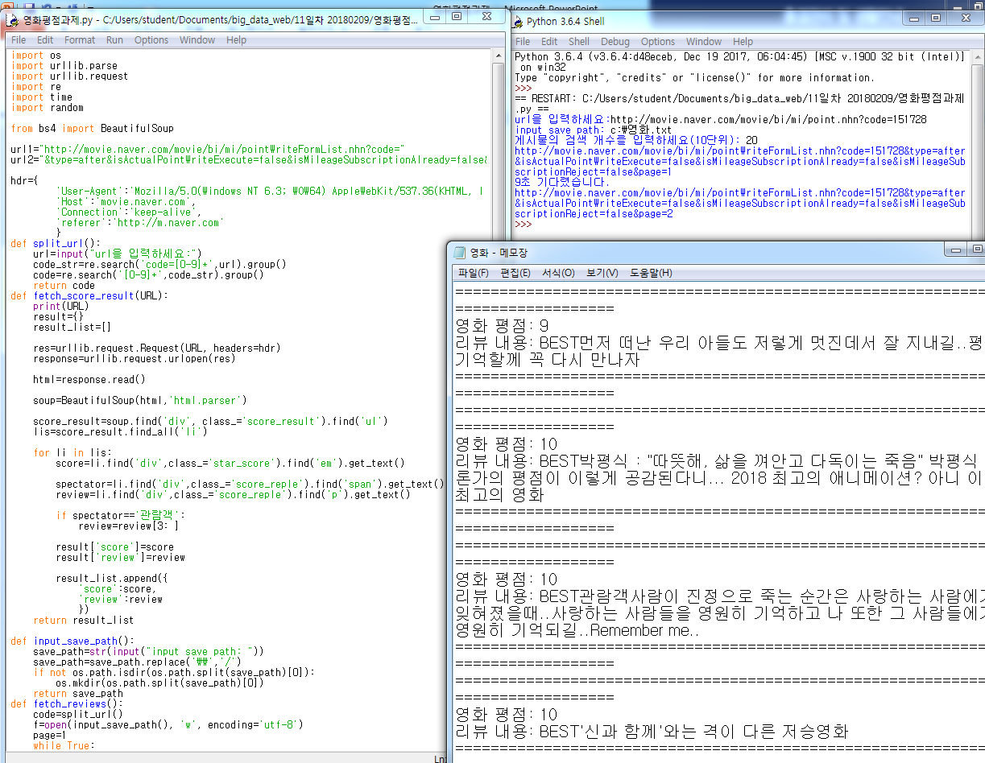
Notes:
import os
import urllib.parse
import urllib.request
import re
import time
import random
from bs4 import BeautifulSoup
url1="http://movie.naver.com/movie/bi/mi/pointWriteFormList.nhn?code="
url2="&type=after&isActualPointWriteExecute=false&isMileageSubscriptionAlready=false&isMileageSubscriptionReject=false&page="
hdr={
'User-Agent':'Mozilla/5.0(Windows NT 6.3; WOW64) AppleWebKit/537.36(KHTML, like Gecko) Chrome/46.0.2490.86Safari/537.36',
'Host':'movie.naver.com',
'Connection':'keep-alive',
'referer':'http://m.naver.com'
}
def split_url():
url=input("url을 입력하세요:")
code_str=re.search('code=[0-9]*',url).group()
code=re.search('[0-9]+',code_str).group()
return code
def fetch_score_result(URL):
print(URL)
result={}
result_list=[]
res=urllib.request.Request(URL, headers=hdr)
response=urllib.request.urlopen(res)
html=response.read()
soup=BeautifulSoup(html,'html.parser')
score_result=soup.find('div', class_='score_result').find('ul')
lis=score_result.find_all('li')
for li in lis:
score=li.find('div',class_='star_score').find('em').get_text()
spectator=li.find('div',class_='score_reple').find('span').get_text()
review=li.find('div',class_='score_reple').find('p').get_text()
if spectator=='관람객':
review=review[3: ]
result['score']=score
result['review']=review
result_list.append({
'score':score,
'review':review
})
return result_list
def input_save_path():
save_path=str(input("input save path: "))
save_path=save_path.replace('\\','/')
if not os.path.isdir(os.path.split(save_path)[0]):
os.mkdir(os.path.split(save_path)[0])
return save_path
def fetch_reviews():
code=split_url()
f=open(input_save_path(), 'w', encoding='utf-8')
page=1
while True:
count=int(input("게시물의 검색 개수를 입력하세요(10단위): "))
if count%10==0:
break
I_count=1
isLoop=True
while isLoop:
URL=url1+code+url2+str(page)
result_list=fetch_score_result(URL)
for r in result_list:
f.write('=='*40+'\n')
f.write('영화 평점: '+ r['score']+'\n')
f.write('리뷰 내용: '+ r['review']+'\n')
f.write('=='*40+'\n')
I_count+=1
if I_count>count:
isLoop=False
break
page+=1
if not isLoop or I_count==count:
isLoop=False
break
sleepTime=random.randint(4,10)
time.sleep(sleepTime)
print(str(sleepTime)+ '초 기다렸습니다.')
f.close()
fetch_reviews()

Slide 7
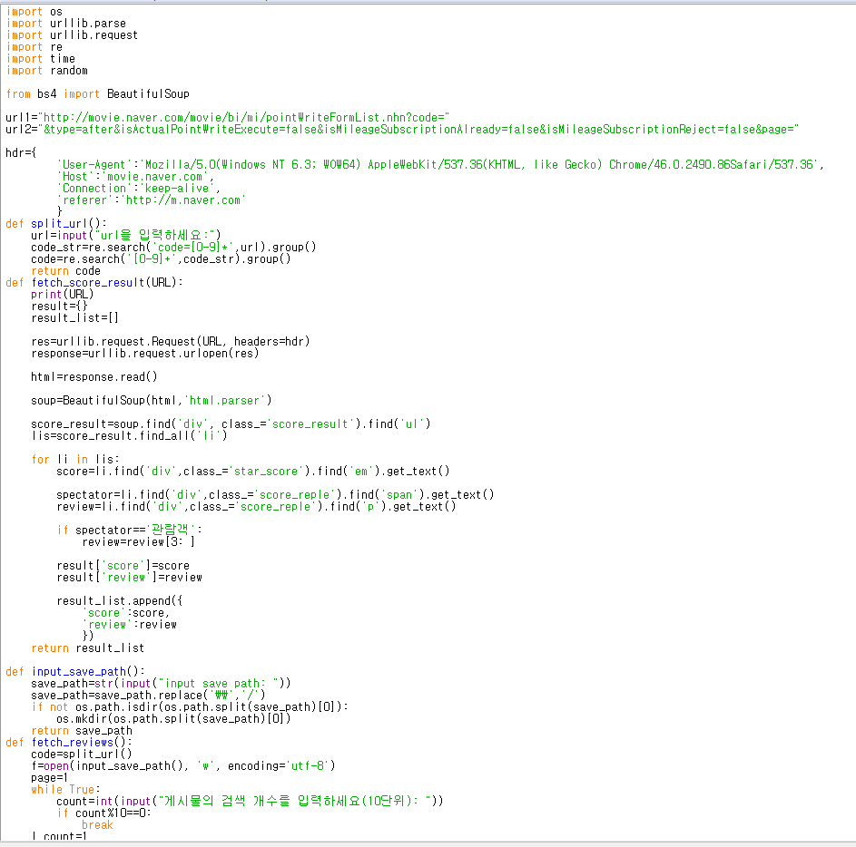
Notes:
import os
import urllib.parse
import urllib.request
import re
import time
import random
from bs4 import BeautifulSoup
url1="http://movie.naver.com/movie/bi/mi/pointWriteFormList.nhn?code="
url2="&type=after&isActualPointWriteExecute=false&isMileageSubscriptionAlready=false&isMileageSubscriptionReject=false&page="
hdr={
'User-Agent':'Mozilla/5.0(Windows NT 6.3; WOW64) AppleWebKit/537.36(KHTML, like Gecko) Chrome/46.0.2490.86Safari/537.36',
'Host':'movie.naver.com',
'Connection':'keep-alive',
'referer':'http://m.naver.com'
}
def split_url():
url=input("url을 입력하세요:")
code_str=re.search('code=[0-9]*',url).group()
code=re.search('[0-9]+',code_str).group()
return code
def fetch_score_result(URL):
print(URL)
result={}
result_list=[]
res=urllib.request.Request(URL, headers=hdr)
response=urllib.request.urlopen(res)
html=response.read()
soup=BeautifulSoup(html,'html.parser')
score_result=soup.find('div', class_='score_result').find('ul')
lis=score_result.find_all('li')
for li in lis:
score=li.find('div',class_='star_score').find('em').get_text()
spectator=li.find('div',class_='score_reple').find('span').get_text()
review=li.find('div',class_='score_reple').find('p').get_text()
if spectator=='관람객':
review=review[3: ]
result['score']=score
result['review']=review
result_list.append({
'score':score,
'review':review
})
return result_list
def input_save_path():
save_path=str(input("input save path: "))
save_path=save_path.replace('\\','/')
if not os.path.isdir(os.path.split(save_path)[0]):
os.mkdir(os.path.split(save_path)[0])
return save_path
def fetch_reviews():
code=split_url()
f=open(input_save_path(), 'w', encoding='utf-8')
page=1
while True:
count=int(input("게시물의 검색 개수를 입력하세요(10단위): "))
if count%10==0:
break
I_count=1
isLoop=True
while isLoop:
URL=url1+code+url2+str(page)
result_list=fetch_score_result(URL)
for r in result_list:
f.write('=='*40+'\n')
f.write('영화 평점: '+ r['score']+'\n')
f.write('리뷰 내용: '+ r['review']+'\n')
f.write('=='*40+'\n')
I_count+=1
if I_count>count:
isLoop=False
break
page+=1
if not isLoop or I_count==count:
isLoop=False
break
sleepTime=random.randint(4,10)
time.sleep(sleepTime)
print(str(sleepTime)+ '초 기다렸습니다.')
f.close()
fetch_reviews()

Slide 8
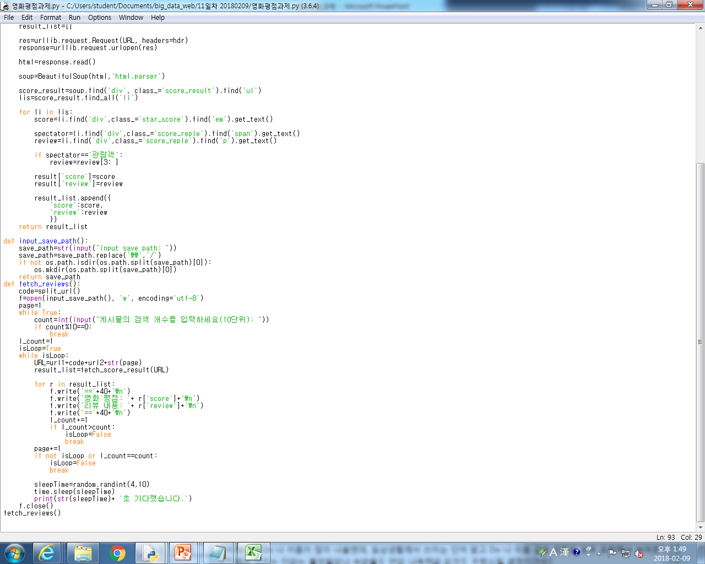
Notes:
import os
import urllib.parse
import urllib.request
import re
import time
import random
from bs4 import BeautifulSoup
url1="http://movie.naver.com/movie/bi/mi/pointWriteFormList.nhn?code="
url2="&type=after&isActualPointWriteExecute=false&isMileageSubscriptionAlready=false&isMileageSubscriptionReject=false&page="
hdr={
'User-Agent':'Mozilla/5.0(Windows NT 6.3; WOW64) AppleWebKit/537.36(KHTML, like Gecko) Chrome/46.0.2490.86Safari/537.36',
'Host':'movie.naver.com',
'Connection':'keep-alive',
'referer':'http://m.naver.com'
}
def split_url():
url=input("url을 입력하세요:")
code_str=re.search('code=[0-9]*',url).group()
code=re.search('[0-9]+',code_str).group()
return code
def fetch_score_result(URL):
print(URL)
result={}
result_list=[]
res=urllib.request.Request(URL, headers=hdr)
response=urllib.request.urlopen(res)
html=response.read()
soup=BeautifulSoup(html,'html.parser')
score_result=soup.find('div', class_='score_result').find('ul')
lis=score_result.find_all('li')
for li in lis:
score=li.find('div',class_='star_score').find('em').get_text()
spectator=li.find('div',class_='score_reple').find('span').get_text()
review=li.find('div',class_='score_reple').find('p').get_text()
if spectator=='관람객':
review=review[3: ]
result['score']=score
result['review']=review
result_list.append({
'score':score,
'review':review
})
return result_list
def input_save_path():
save_path=str(input("input save path: "))
save_path=save_path.replace('\\','/')
if not os.path.isdir(os.path.split(save_path)[0]):
os.mkdir(os.path.split(save_path)[0])
return save_path
def fetch_reviews():
code=split_url()
f=open(input_save_path(), 'w', encoding='utf-8')
page=1
while True:
count=int(input("게시물의 검색 개수를 입력하세요(10단위): "))
if count%10==0:
break
I_count=1
isLoop=True
while isLoop:
URL=url1+code+url2+str(page)
result_list=fetch_score_result(URL)
for r in result_list:
f.write('=='*40+'\n')
f.write('영화 평점: '+ r['score']+'\n')
f.write('리뷰 내용: '+ r['review']+'\n')
f.write('=='*40+'\n')
I_count+=1
if I_count>count:
isLoop=False
break
page+=1
if not isLoop or I_count==count:
isLoop=False
break
sleepTime=random.randint(4,10)
time.sleep(sleepTime)
print(str(sleepTime)+ '초 기다렸습니다.')
f.close()
fetch_reviews()

Slide 9
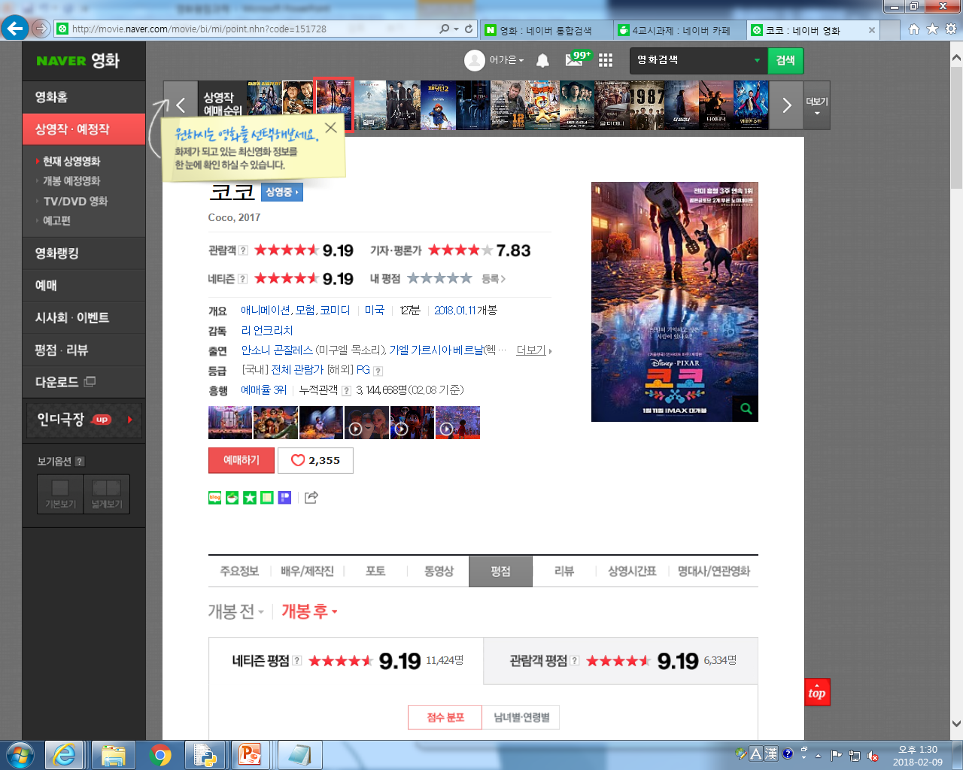
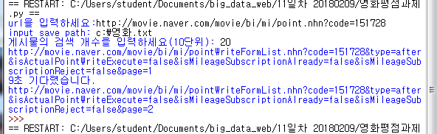
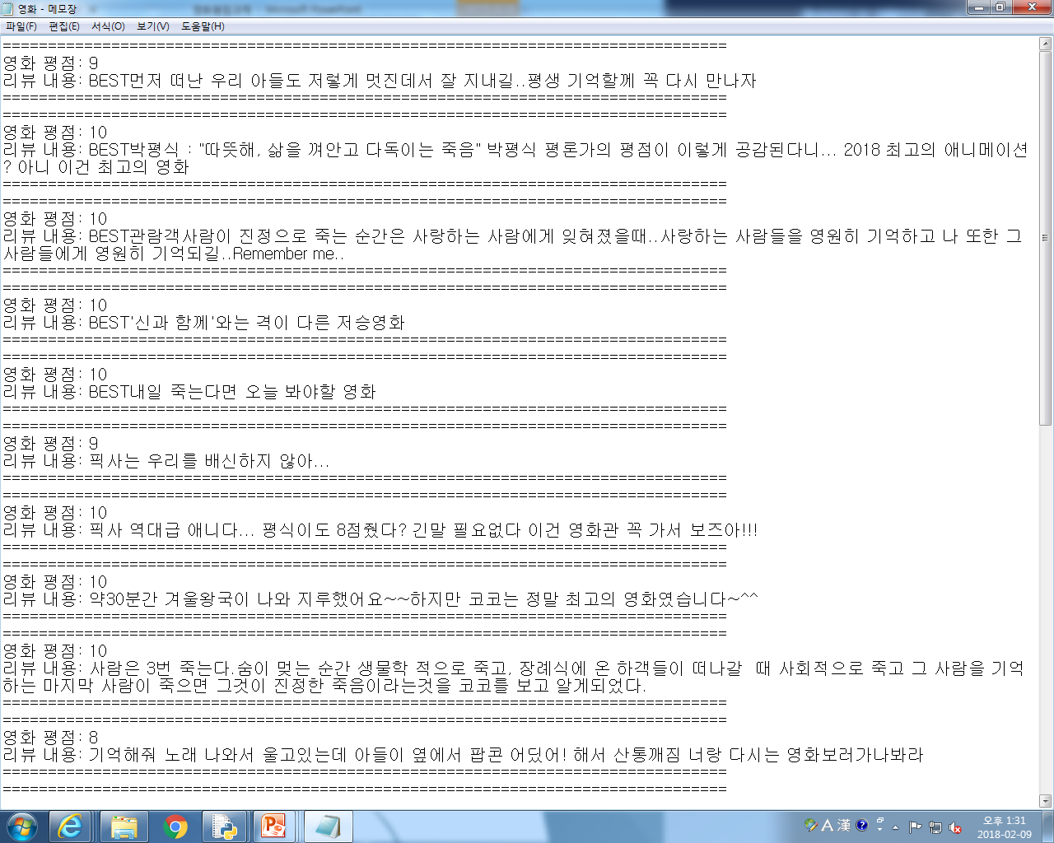
1.Naver 홈페이지
2.영화 검색
3.보고싶은 코코 영화 들어가기
4.영화 코코 평점 보기
5.맨 위 주소 복사
파이썬 실행하기(F5새로고침)
url 입력
경로와 파일명 입력
게시물 검색 개수 입력
C로 들어가 메모장으로 실행

Slide 10
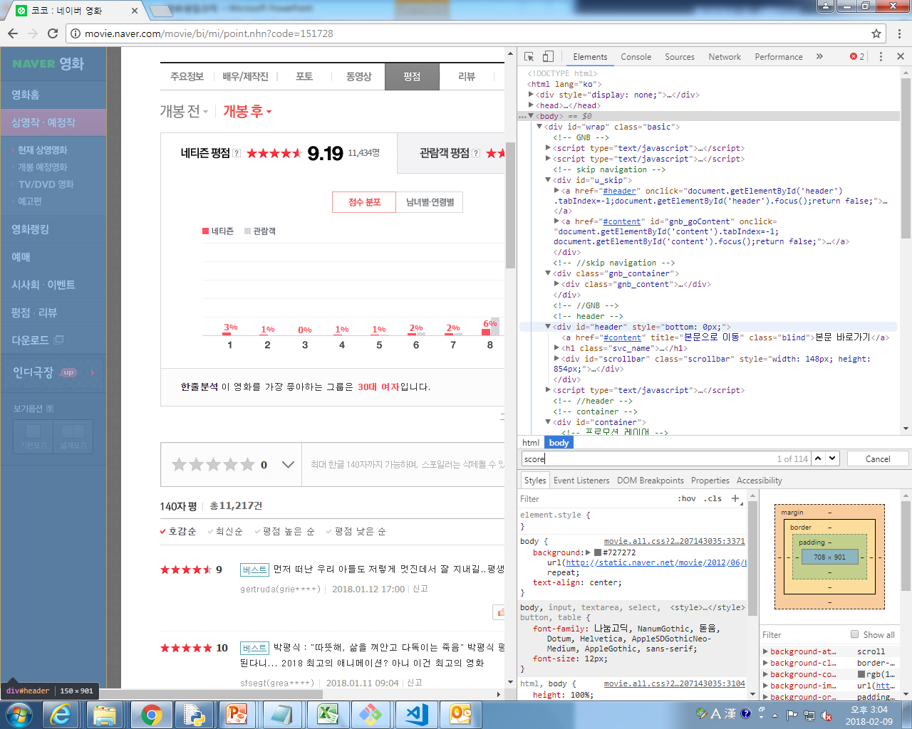

Slide 11
import re
Python에서 정규식을 사용하기 위한 모듈을 불러냄
Encoding “utf-8”
파일을 utf-8로 인코딩 하겠다.
Key
#네이버 api에서 발급받은 open API Key 값을 넣음
Code=getCode(URL)
=>#위에 입력한 URL에서 코드 얻어오기
getReviewResul(code)
=>위에 입력한 URL을 시작으로 평점, 리뷰, 날짜 가져오기 실행코드

Slide 12
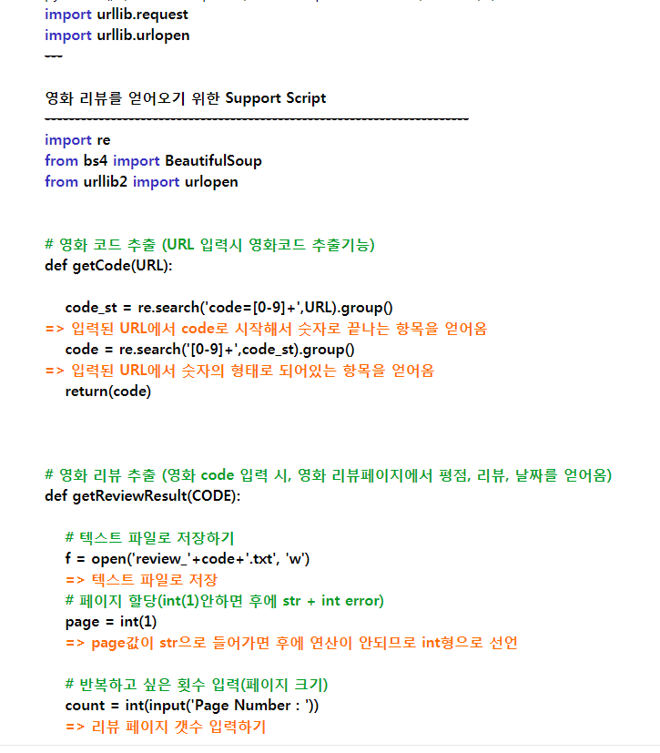
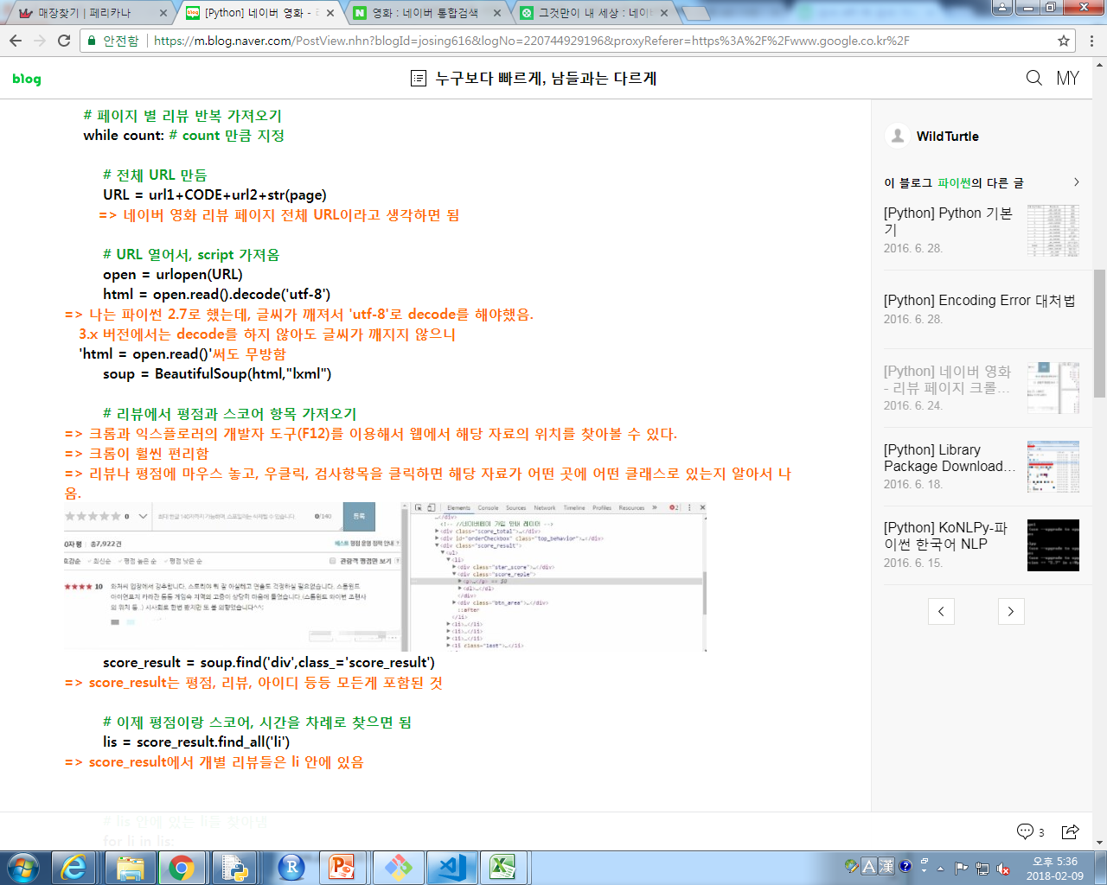

Slide 13
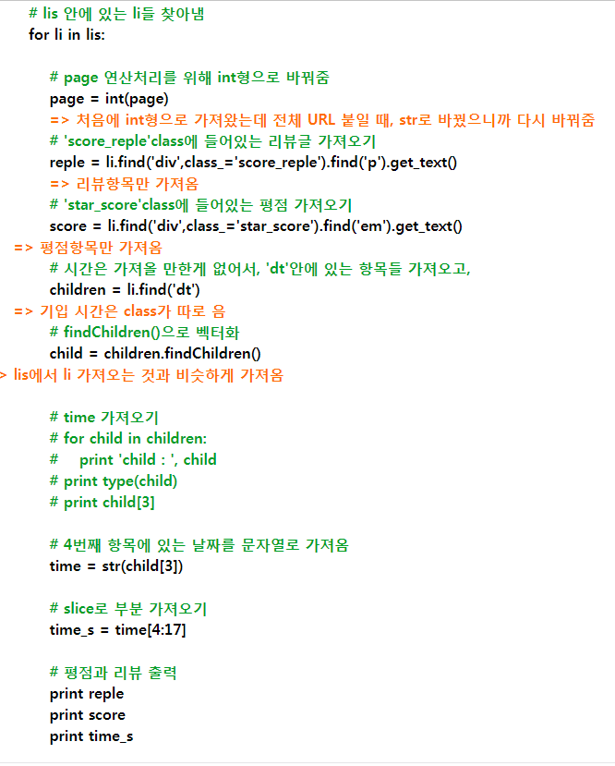
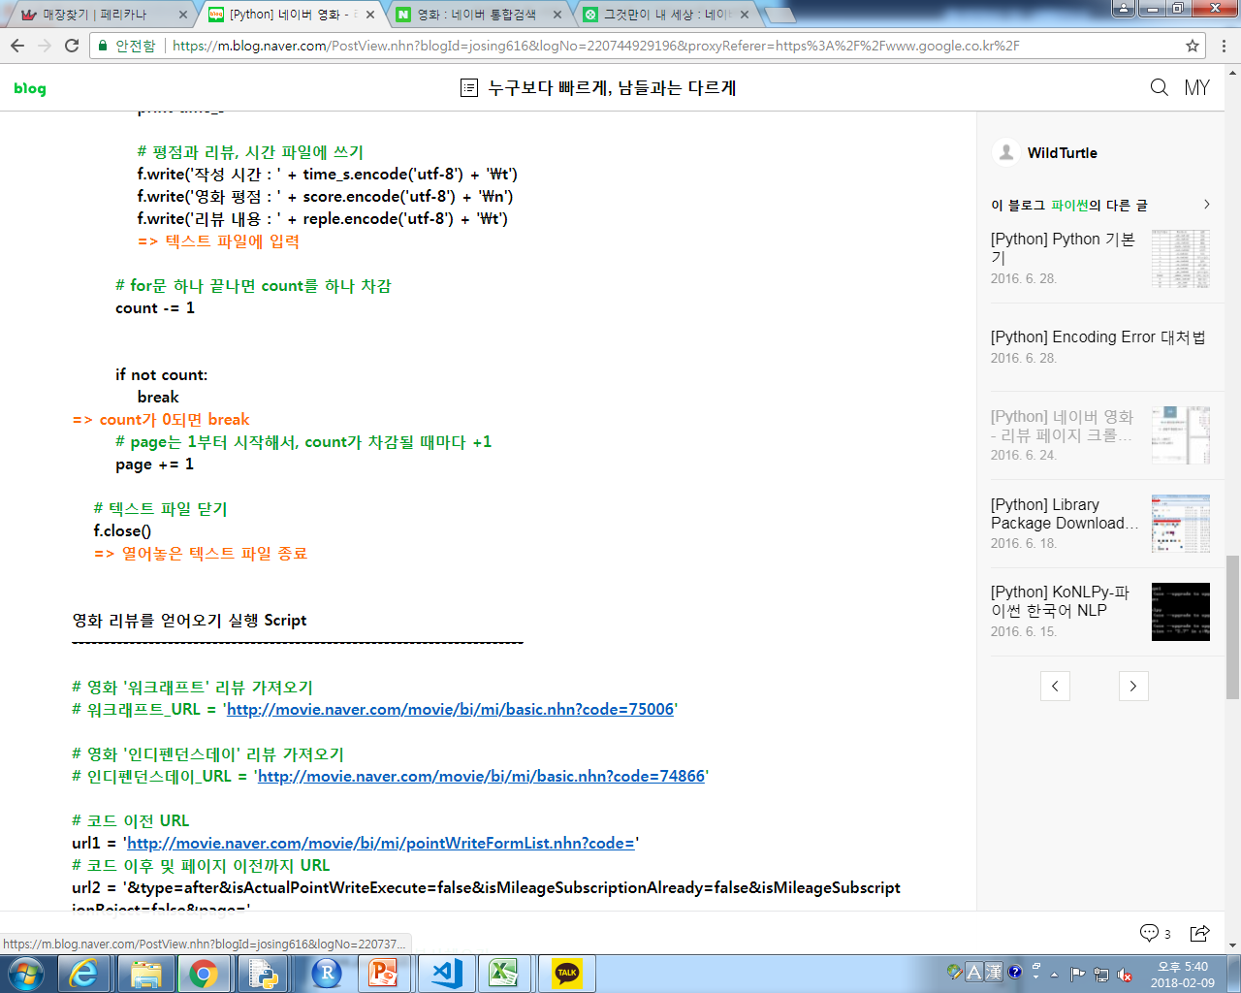

Slide 14
